Slide 1


Innovation and Design Thinking Project(21IDT28)
on "Highway accidents detection alarm system"
MYSORE UNIVERSITY SCHOOL OF ENGINEERING
Manasagangotri campus, Mysuru-570006
(Approved by AICTE, New Delhi)
Presented By II Semester, Section E
1. Rakshitha.G, 22SECD63.
2. Umme Kulsum, 22SEAD68.
3. Unnath M Gangatkar, 22SEAI68.
4. Unnathi MB, 22SEAD69.
5. V Sammedh Jain, 22SECD89.

Slide 2
Contents
Introduction .
Literature survey.
Problem statement.
Methodology.
Benefits.
Conclusion.

Slide 3
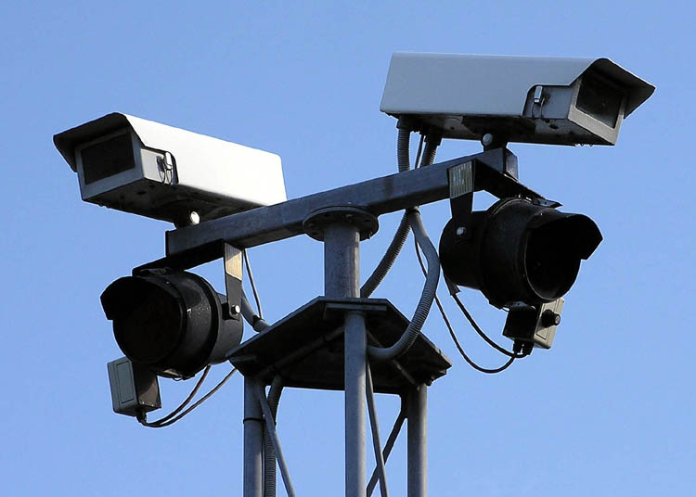
Introduction
The Highway Accidents Detection Alarm System (HADAS) is an advanced technology-driven solution aimed at enhancing the efficiency and response time of local traffic police, emergency services to highway accidents.HADAS will significantly reduce the response time, ensuring prompt assistance to victims and quicker clearance of accident sites, leading to improved traffic flow and enhanced road safety.

Slide 4
Literature Survey
"Real-Time Detection of Highway Accidents using Vehicle Telematics Data"
Authors: Smith, Johnson, Brown.
"A Comprehensive Review of Accident Detection Systems for Intelligent Transportation Systems"
Authors: Gupta, Sharma, Agarwal.
"Integration of Radar and Image Processing for Highway Accident Detection"
Authors: Lee, Park , Kim.

Slide 5
Problem Statement
The project aims to design and implement a Highway Accidents Detection Alarm System (HADAS) to address the following challenges:
Real-Time Accident Detection:
Prompt Alert System:
Data Privacy and Security:
Integration with Existing Infrastructure:
Cost-Effectiveness:

Slide 6


Key Components and Functionality
Sensor Network

Slide 7


Image and Video Analysis using high-resolution cameras

Slide 8

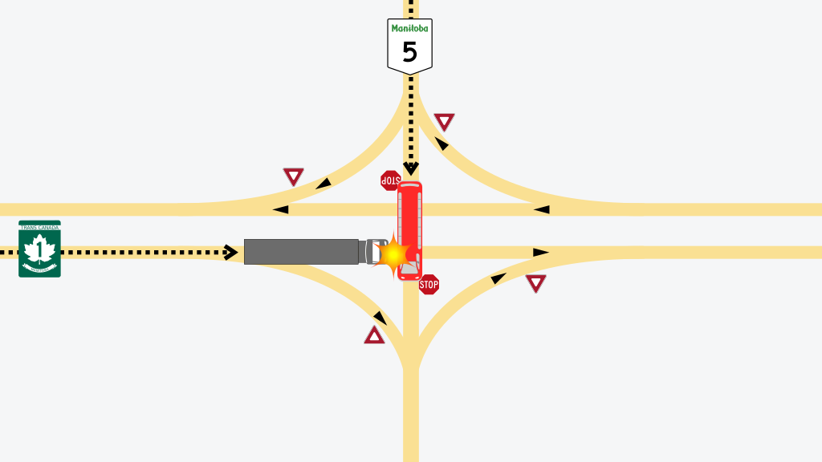
Artificial Intelligence (AI) Algorithms

Slide 9
Benefits of HADAS:
Enhanced Safety:
Reduced Response Time:
Improved Traffic Flow:
Data-Driven Decision Making:
Cost-Effective Solution:

Slide 10
Conclusion:
The Highway Accidents Detection Alarm System (HADAS) offers a cutting-edge approach to highway safety by leveraging advanced technologies for real-time accident detection and response. With its ability to promptly alert local traffic police and emergency services, HADAS has the potential to save lives, reduce accidents, and enhance the overall efficiency of traffic management on highways. By integrating this system with existing infrastructure, authorities can work towards creating safer and more secure roadways for the public.

